Slide 1
Rainbow Table Attack Lab

Slide 2
Rainbow Table Attack Lab
In this lab students will perform password cracking via the use of rainbow tables.
Materials needed
Kali Linux
Software Tools used
rainbowcrack (Password Cracking Tool)

Slide 3
Objectives Covered
Security+ Objectives (SY0-501)
Objective 1.2 - Compare and contrast types of attacks
Cryptographic attacks
Rainbow Tables

Slide 4
What is a Hash?
A hashing algorithm is an algorithm that converts input data (or a message) of varying size to a hash output of a fixed size
A hash is a one-way function, impossible to revert.
The output value of a hash is unique to the input (no two inputs share the same output)
Generally, the longer the fixed output the less possibility of collisions (two inputs producing the same output), thus the more secure the hashing algorithm
SomeBigLongValue |  | 33ce0634
tinyval |  | 0c430308
NggYuNgLYDngraaDY |  | 3803062f
Variable size input |  | Fixed size output
Notes:
adler32 hasing algorithm used for examples

Slide 5
What is a Rainbow Table?
Pre-calculated series of hashes using known hashing algorithms
Commonly used for cracking passwords
Find the matching hash string of text
Look up the input text that gave the result
Voila! There’s the password/input string
Rainbow tables are application-specific
Built for each different application or OS
No one table for all uses
Plaintext | MD5 Checksum
Alice | 64489c85dc2fe0787b85cd87214b3810
Bob | 2fc1c0beb992cd7096975cfebf9d5c3b
Carol | 150c16d9d096e70af3596111d7402397
Dave | 083d9a270e6e16b2fbb08d35067aae5f
Notes:
MD5 hash of Plaintext usernames

Slide 6

How does a Rainbow Table work?
Get the first X characters of a hash
Hash these characters
Get the first X characters of that hash
Hash these characters
Do this repeatedly…
This creates a "chain"
Each chain can be referred to as a color "red" (first hash), "orange" (second hash), "yellow" (third hash), etc.
After obtaining enough chains, they create a table
A table of all the colors... like a rainbow. Hence a "rainbow table".
Only store the plaintext and final hash value for each chain
All values in between plaintext and final hash can be re-computed as needed

Slide 7
How does a Rainbow Table work?
To use the table, take the first X characters of the target hashed password and look for a match in the table.
If a match is not found, take the first X characters, hash, and search again
If a match is found, you know the plaintext at the front of that chain is part of the target password – this narrows the search by X characters.
Take the next X characters and start the process again
It is a narrowing down of the thousand and millions of possibilities

Slide 8
Rainbow Tables vs. Brute Force
Advantages of a Rainbow Table
No need to match the whole string, looking for parts
Not trying all values, only searching a table (fast)
Can be done offline
System does not know attempts are being made to crack the password of its users!
Advantages of a Brute Force
Does not need to store the large Rainbow Table dataset
Which can be large! Can be gigs of text or even terabytes
Works for all passwords, just takes time (lots and lots and lots of time)

Slide 9
The Rainbow Table Attack Lab
Log into Kali Linux
Create Rainbow Table
Create Hashes from example passwords
Use Rainbowcrack to crack a hash
Use Rainbowcrack to crack a file of hashes
Observe the results

Slide 10

Log into Kali Linux
Open the Kali Linux Environment
Open Terminal
Login as the root user with the following command:
sudo su -
Notice the command prompt is now root@kali

Slide 11
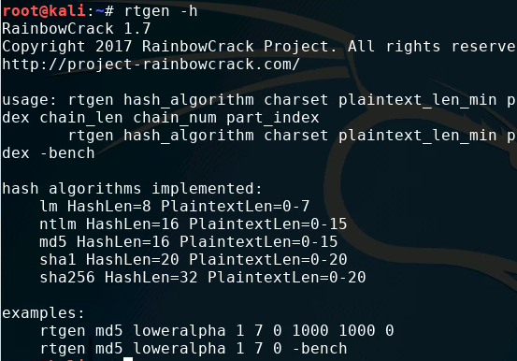
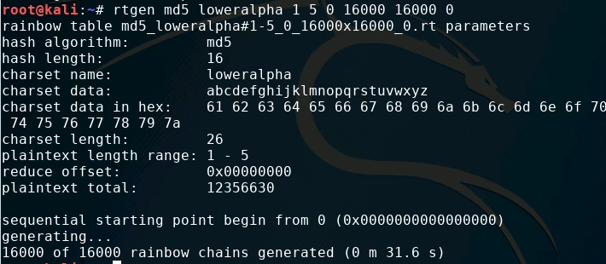
Create Rainbow Table
Type the following command*:
rtgen -h
Read the options available when using this command to create a rainbow table
Type the following command:
rtgen md5 loweralpha 1 5 0 16000 16000 0
This will create a rainbow table using the MD5 hash algorithm with a hash length of 16 based on input restricted to 5 characters that are lowercase letters
This will take time!
*Use the following command to install Rainbowcrack (if not installed):
sudo apt-get install rainbowcrack

Slide 12
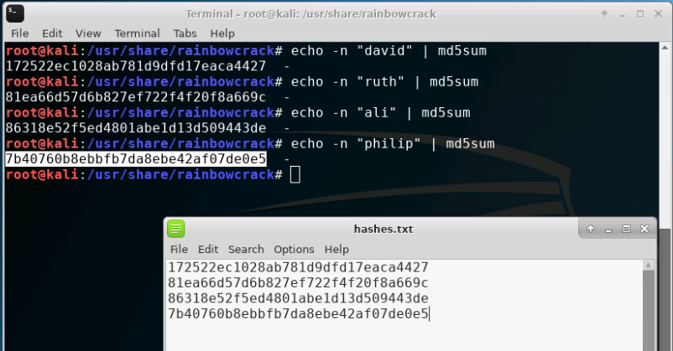
Create Hashes
Navigate to the folder with Rainbowcrack
cd /usr/share/rainbowcrack
Create a new file called “hashes.txt”
touch hashes.txt
In the original terminal create a sample hash for a 5 character lowercase input by using the following command:
echo –n "david" | md5sum >> hashes.txt
Use leafpad (or some other editor) to review the hashes.txt file
Remove any extraneous text after the MD5 digests
Repeat this process at least three more times with other names. Each hash should be on a new line in the hashes.txt file
Notes:
You can also use awk: echo -h "david" | md5sum | awk '{print $1}' >> hashes.txt

Slide 13
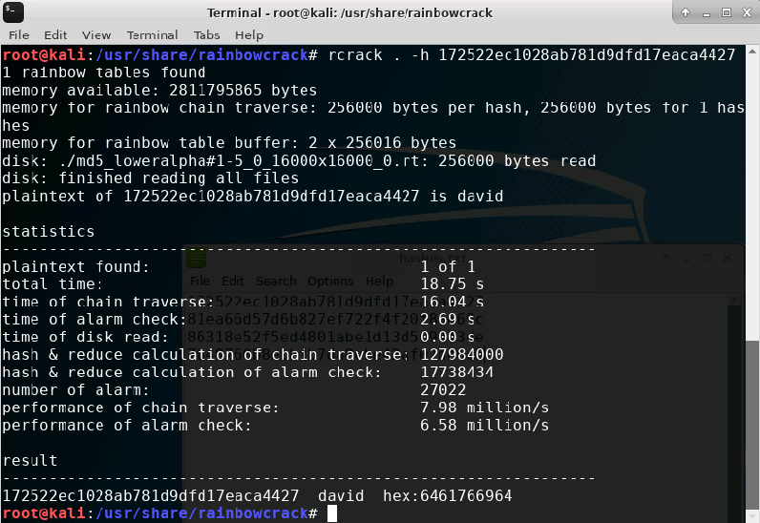
Crack a Hash using Rainbowcrack
Hash from “david”
First run the following command to sort all .rt tables in the current directory to make binary search possible
rtsort .
Copy the MD5 hash output from the previous command:
echo –n "<name>" | md5sum
Crack the hash using the command
rcrack . –h <MD5 hash>
Observe the output with the plaintext answer shown for the matching hash

Slide 14
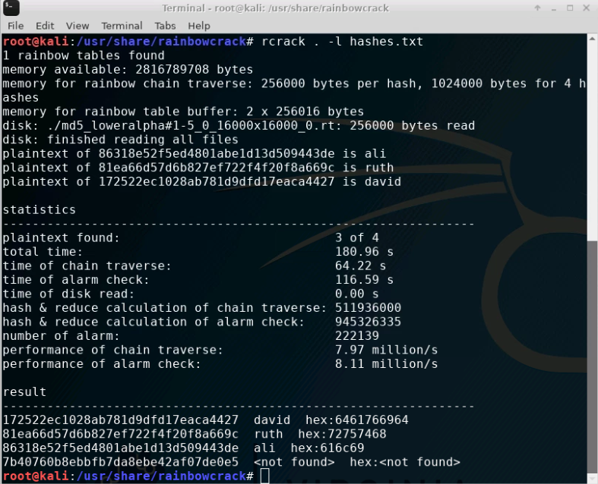
Crack a file of hashes using Rainbowcrack
Crack multiple hashes at once stored in a file using the command:
rcrack . –l <filename>

Slide 15
Observe the Results
The rainbow table created, solved 3 out of 4 hashes
The one plaintext it did not find was for “philip” which is more than 5 characters
If the word is between 1-5 characters in length, the table can solve ~100% of the password
The more rainbow tables we generate, and the longer they are, the more possibilities to crack the password – however long tables require a LOT of space!

Slide 16
How to Defend against Rainbow Table Attacks
Salt those passwords!
A salt is string of characters added to a password before it is hashed
Using a unique salt for each user makes using a rainbow table more difficult.
The rainbow table has to be recomputed for each user.
If a password is found, which part is the hash and which is the password?
Key Stretching
“Hashing the hash”
Hashed values are hashed multiple times to increase the computation time required to hash each password
How else can you defend against Rainbow Tables?

